Slide 1

The future of ice sheets and sea-level rise
Notes:
This presentation was given at the European Parliament in Brussels on the 27th June 2012. It was aimed as a lunchtime briefing to MEPs, European Commission representatives, and other key personnel from relevant public bodies.
This briefing was to provide an opportunity to for these audiences to question senior researchers from across Europe working together at the forefront of sea-level science. We presented an overview of factors affecting sea-level, insight into measurement of current sea-level rise, and discussion of the role of sea-level projections in supporting policy development.
Please note images have been compressed in this version to minimise file size, higher resolution images may be available on request. These note sections explain the main points that we wanted to get across on that slide. If you have any further questions on the content of this presentation, or the ice2sea project as a whole, please contact Elaina Ford (Programme Manager) at ice2sea@bas.ac.uk.
We hope you find this presentation useful.

Slide 2
Chris Davis
Euro-MP for North West England
Welcome by MEP host
Notes:
Chris Davis was the host MEP for this event and provided the introduction and welcome. He noted he hosted this event as he recognises that if the predicted sea-level rise does happen, then there are large implications, and that he was hoping this briefing would provide convincing material to argue with sceptics.

Slide 3
Manuela Soares
Director: environment, DG Research and innovation
European commission
Introduction
Notes:
Manuela Soares is the head of the Unit in the EC of which ice2sea is a part. She noted that ice2sea is expanding knowledge of sea-level rise, and that the project came about from the IPCC AR4 report (described in more detail below, slide 25). There needs to be a pan-European effort on policy recommendations on consequences of sea-level rise. Horizon 2020 (the research arm of the EC’s Europe 2020 strategy) has a main theme of tackling societal challenges – and climate change is an important aspect of this.

Slide 4
David Vaughan ice2sea co-ordinator - British Antarctic survey
Sea-level rise and policy
Notes:
The focus of this talk is to explain how sea-level rise is an issue that is significant the business of this policy makers, and why we (in ice2sea) are putting so much effort into developing improved sea-level projections.

Slide 5
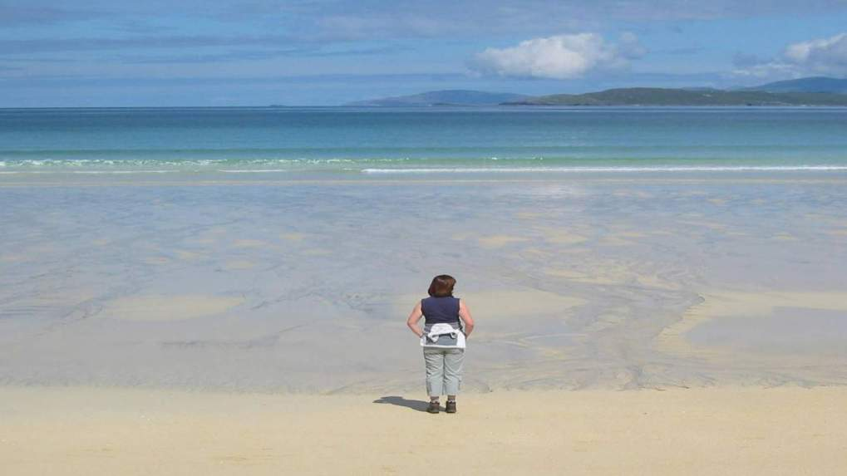
Sea-level rise and climate
Photo: David Vaughan
Notes:
The aim is to promote a dialogue between science and the instruments of policy-making. It’s also an opportunity for us scientists to begin to understand what we can do to assist in supporting development of evidenced-based policies that guarantee sustainable development in Europe.
Sea-level change is part of the wider discussion on climate change that has received particular attention in recent years, in ways that have both promoted awareness but, I would argue, have also obstructed rational debate. And if I do one thing here, I’m hoping to convince you that the importance of sea-level rise has nothing to do with chasing us up the beach.

Slide 6
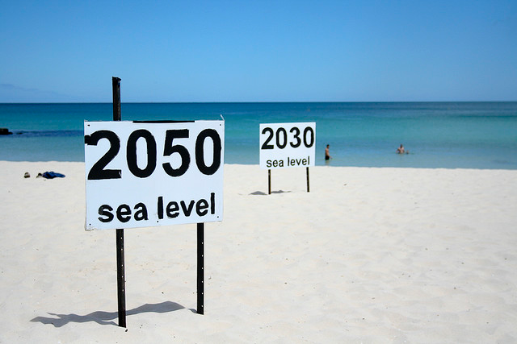
Sea-level rise
Photo: flickr/go_greener_Oz
Notes:
For many campaigning groups, indeed the majority of the Green lobby, sea-level rise has essentially become the poster child of climate change. In part this is because sea-level rise yields such immediately graphic images, such as this.
But these images, and the story lines behind them, don’t in my opinion convey a real understanding of the changing risks associated with sea-level.

Slide 7
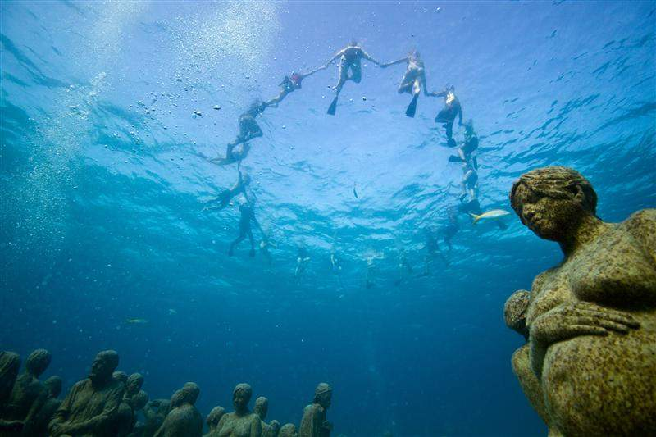
Sea-level rise
Long-term (decades to centuries)
Emissions reduction?
Short-term (decades)
Adaptation
Photo: flickr – Igor Podgorny
Notes:
Moving from Flood Defence to Flood Risk Management.
Flood Risk
=
Probability (which decreases as increasingly large defences are built)
X
Consequence (which increases as people move in and develop behind the defences)
We are used to the concept of probability (likelihood) of flooding and it can be measured fairly easily. Consequence is more difficult and our studies are enabling us to measure the risk and the value of reducing the consequence through flood risk management measures within the flood plain. These are known as “Receptor” responses.
Some of the stunts that campaigners have used to raise awareness are increasingly bizarre, this one in particular seems to be particularly obscure.
This obscures the two very important aspects of sea-level rise both of which arise from the fact that sea-level rise will continue long after carbon emissions have ceased and climate itself has stabilized.
In the long-term (several centuries), this means there could be a long-term commitment to sea-level rise (several centuries) that results from the emissions we’re making today.
In the short-term timescales (decades), this means there is nothing we can do to prevent sea-level rise, and given the high sensitivity, our only option to protect human assets and the natural environment is to prepare strong adaptation strategies.

Slide 8
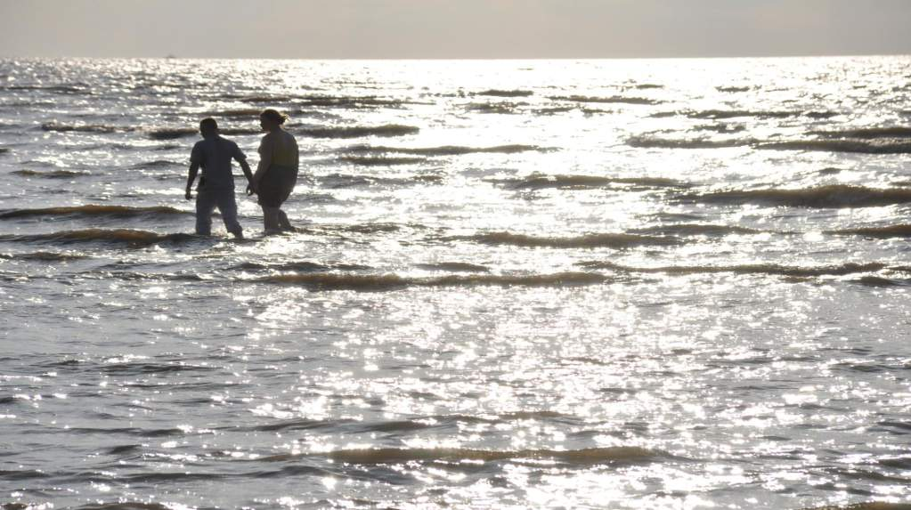
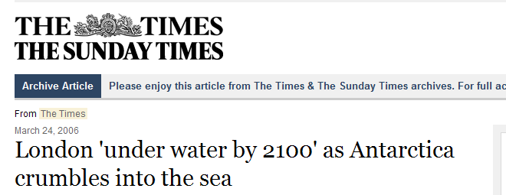
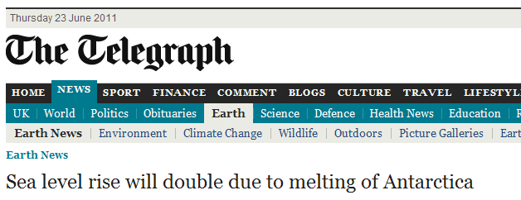
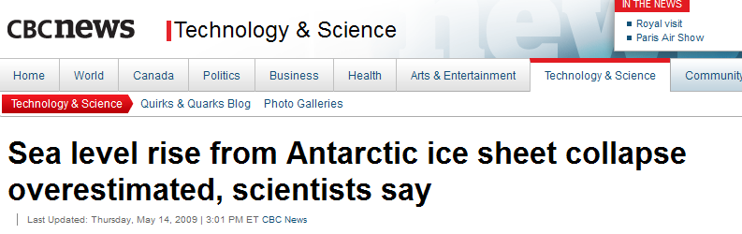
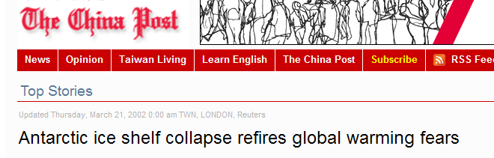
Sea-level in the media
Notes:
Our media, even the serious media, seem to think that sea-level rise is an issue that they can bat around in an almost comical way.

Slide 9
Sea-level projections in policy
Climate change mitigation / carbon emissions agreements
  (UNFCCC)
Integrated Coastal Zone Management
  (EU Recommendation, 2002 )
Local flood-risk coastal defence management
  (EU Floods Directive, 2007)
Planning of national/commercial investment in coastal assets
  (e.g. Netherlands Deltacommissie, 2008)
Notes:
The future of sea-level rise is thus significant across a wide range of policy areas - from the global to the local…
At the global and intergovernmental level, the long term commitment to sea-level rise, long after human carbon emissions have leveled-off, or even ceased, together with the inequitable impact of sea-level rise on some small island states, is a particular issue for the negotiations taking place under the UNFCCC.
At a European level, European Parliament has already recognized the importance of Integrated Coastal Zone Management which needs to take account of sea-level rise
The European Directive on Floods requires that nations undertake flood risk assessment and mapping, and this is due in 2013.
Finally, our national, regional, and local strategies regarding management of local sea-defence infrastructure.

Slide 10
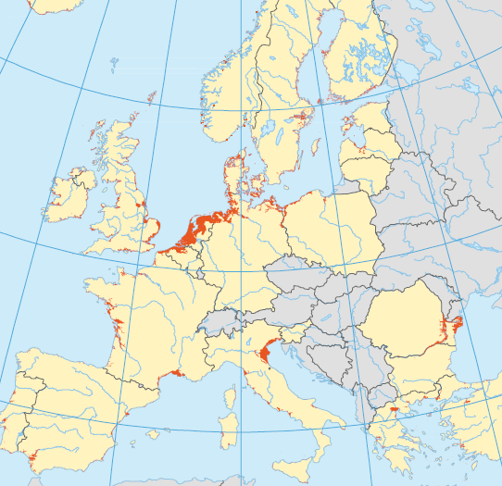
Areas of Europe within 1 m of sea level
Notes:
Europe has a variety of coastlines, some of which are more vulnerable than others, and it is not just elevation that determines that vulnerability or risk…
You can see we have significant areas of low-lying coast (red areas are within 1m of mean sea level) in the Mediterranean and Black Seas, on the Atlantic Coasts.
Arguably the most vulnerable low-lying coasts are around the North Sea and Baltic Coasts, where storm surges that travel across the north Atlantic are magnified due to its relatively shallow depth.

Slide 11
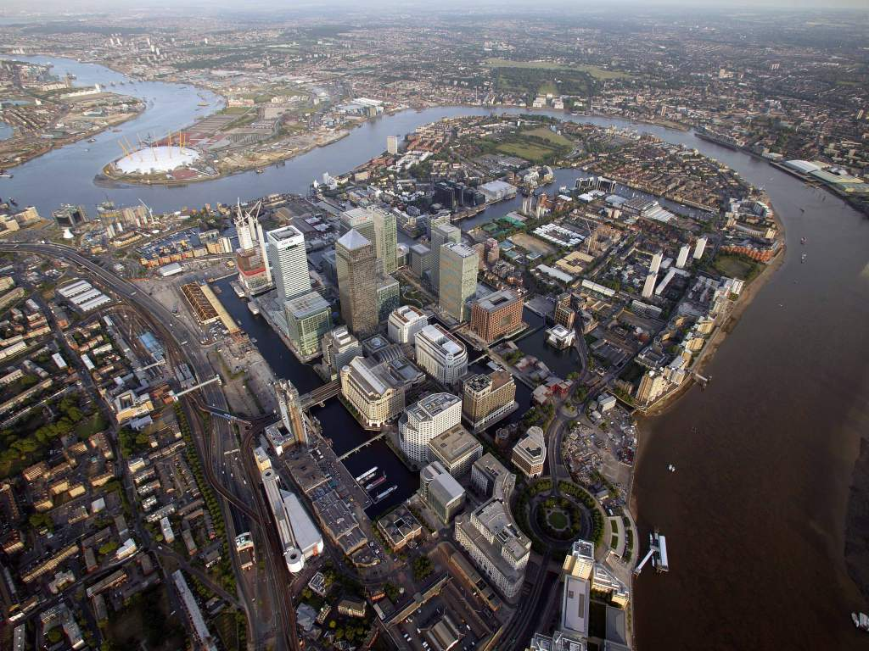
Major coastal cities
    Photo: UK Environment Agency
Notes:
Moving from Flood Defence to Flood Risk Management.
Flood Risk
=
Probability (which decreases as increasingly large defences are built)
X
Consequence (which increases as people move in and develop behind the defences)
We are used to the concept of probability (likelihood) of flooding and it can be measured fairly easily. Consequence is more difficult and our studies are enabling us to measure the risk and the value of reducing the consequence through flood risk management measures within the flood plain. These are known as “Receptor” responses.
Several of our major cities – London shown here, Amsterdam, Rotterdam, Hamburg, etc., all have a high density of critical assets in these vulnerable low lying areas.

Slide 12
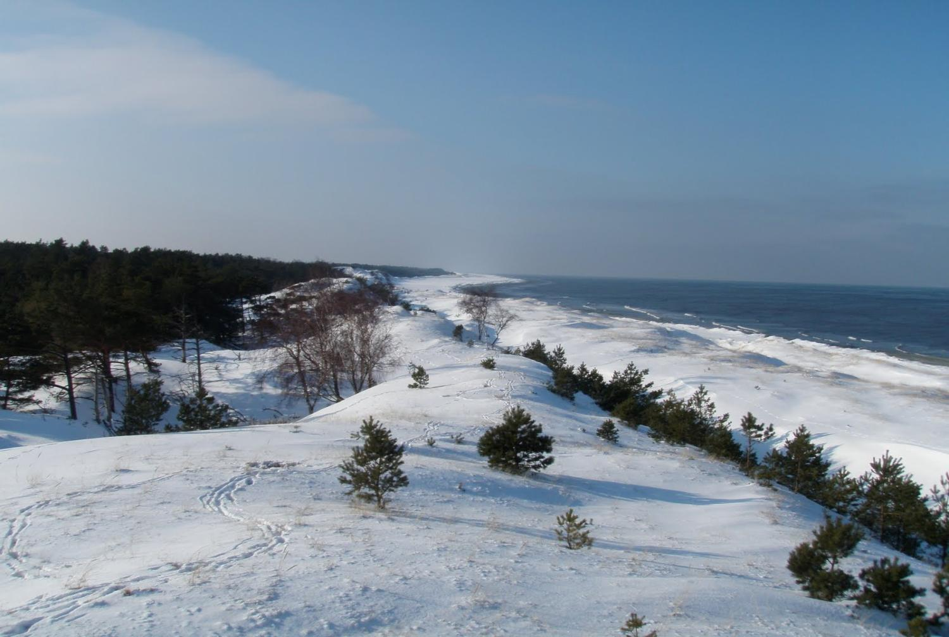
Unique coastal landscapes
e.g. Sand dunes in Solwinski National Park – Poland
    Photo: QRT300
Notes:
Moving from Flood Defence to Flood Risk Management.
Flood Risk
=
Probability (which decreases as increasingly large defences are built)
X
Consequence (which increases as people move in and develop behind the defences)
We are used to the concept of probability (likelihood) of flooding and it can be measured fairly easily. Consequence is more difficult and our studies are enabling us to measure the risk and the value of reducing the consequence through flood risk management measures within the flood plain. These are known as “Receptor” responses.
In addition, many unique natural assets are already showing signs of erosion.

Slide 13
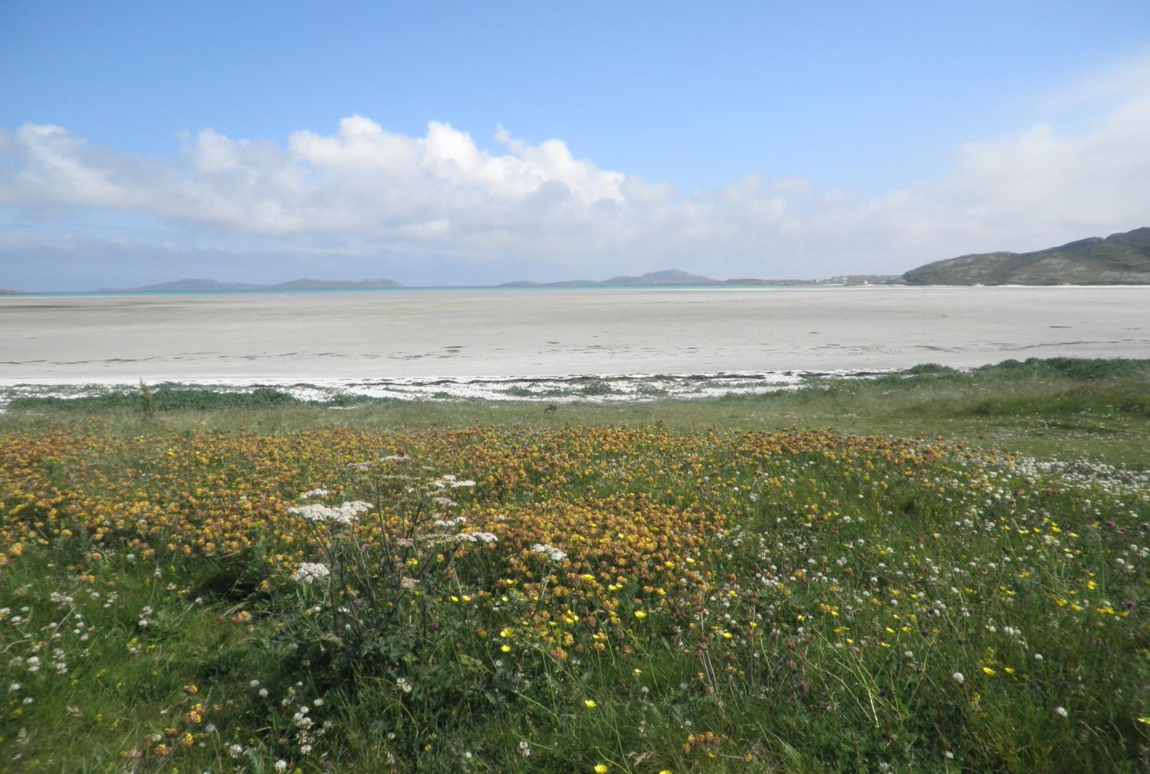
Unique coastal ecology
e.g. “Machair” environments in Ireland and Scotland
    Photo: Alison Cook
Notes:
Moving from Flood Defence to Flood Risk Management.
Flood Risk
=
Probability (which decreases as increasingly large defences are built)
X
Consequence (which increases as people move in and develop behind the defences)
We are used to the concept of probability (likelihood) of flooding and it can be measured fairly easily. Consequence is more difficult and our studies are enabling us to measure the risk and the value of reducing the consequence through flood risk management measures within the flood plain. These are known as “Receptor” responses.
We have many areas of unique coastal habitats that have survived for thousands of years, and can survive some sea-level rise, but not if it is too rapid.

Slide 14
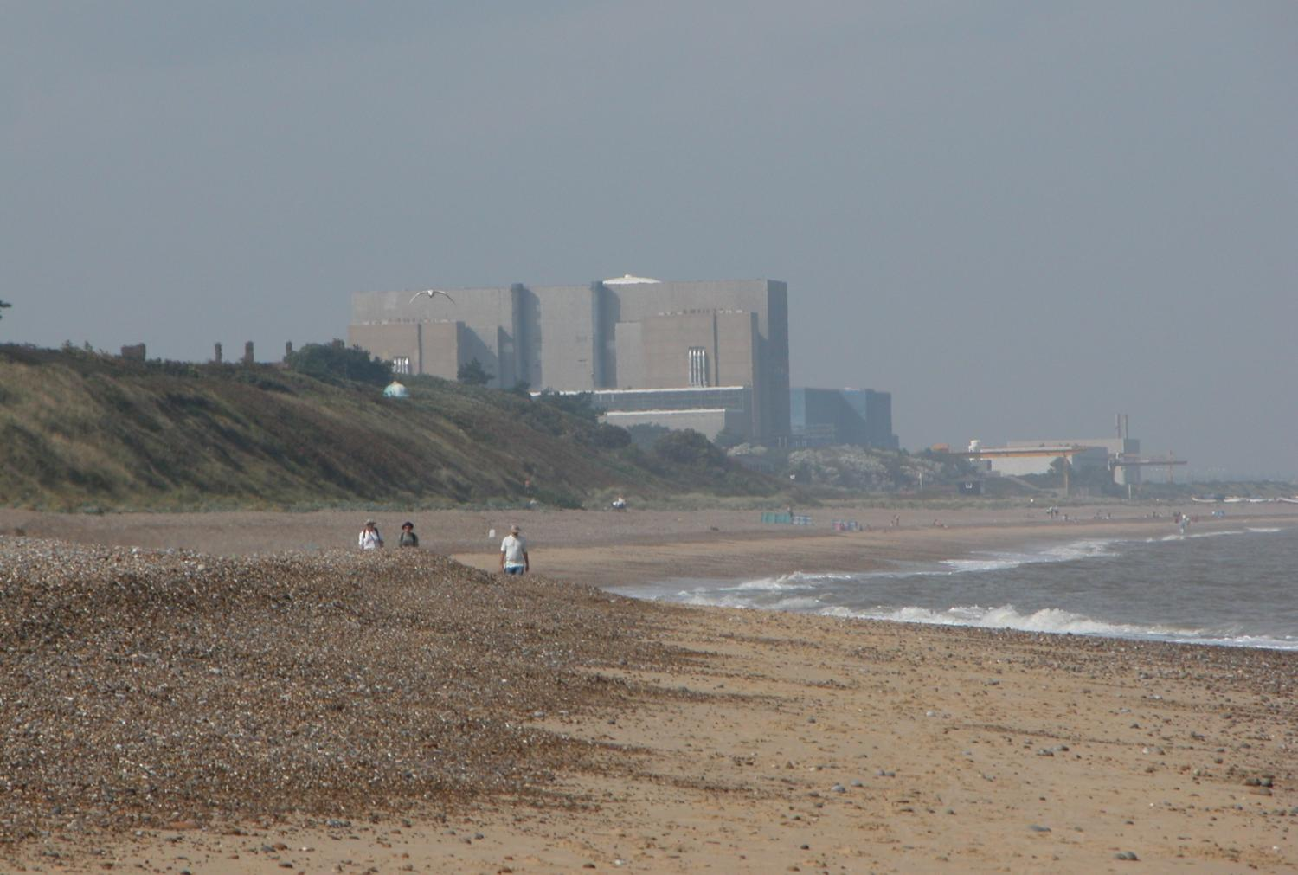
Coastal investment
e.g. Sizewell B Nuclear Power Station (England)
    Photo: William Connolley
Notes:
Moving from Flood Defence to Flood Risk Management.
Flood Risk
=
Probability (which decreases as increasingly large defences are built)
X
Consequence (which increases as people move in and develop behind the defences)
We are used to the concept of probability (likelihood) of flooding and it can be measured fairly easily. Consequence is more difficult and our studies are enabling us to measure the risk and the value of reducing the consequence through flood risk management measures within the flood plain. These are known as “Receptor” responses.
Finally, we have many coastal infrastructures of great value and long-projected lives that are measured in many decades.
This is the second nuclear reactor at Sizewell on the English coast, and another is currently beginning its journey through the planning process.

Slide 15
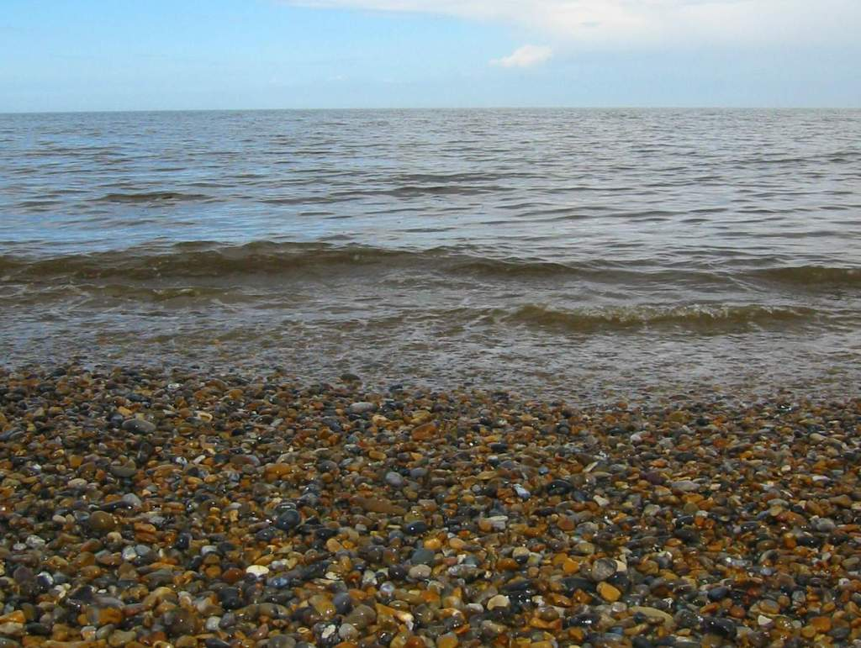
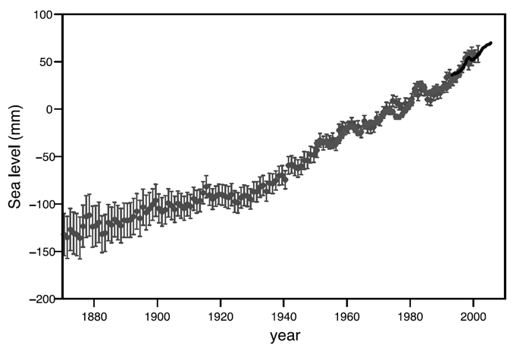
Recent observed global sea-level rise
3.2 mm/year
2.0 mm/year
Satellites
0.8 mm/year
Tide gauges
Steve Nerem
Notes:
15
Sea-level rise has been measured using tide gauges for the past 150 years, and using satellites for the last couple of decades. There is no doubt that the global average sea-level is rising.
Today, sea-level is rising at >3 mm per year. Also, the rate of its sea-level rise is increasing.

Slide 16
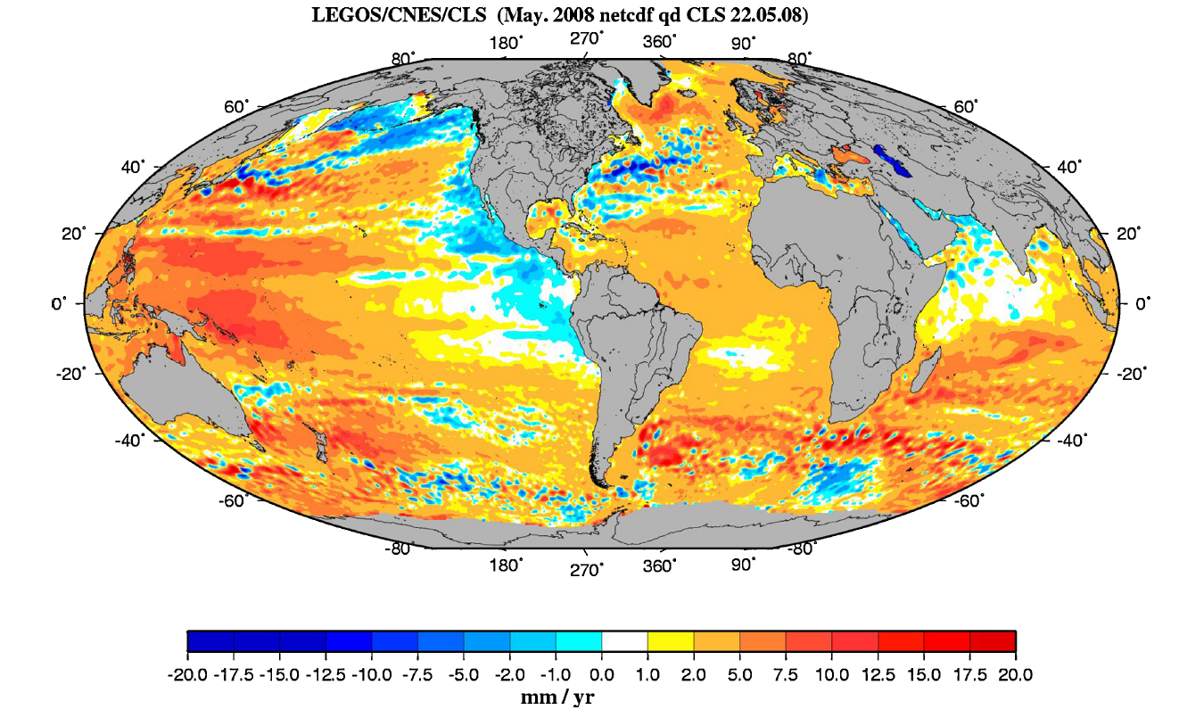
Global mean sea-level change
Cazenave , 2008
Notes:
But sea-level rise is not uniform across the globe. Viewed from satellites there are clear areas of more or less rapid change than the global average. Currently Europe is seeing something close to the average (3.2mm/year).

Slide 17
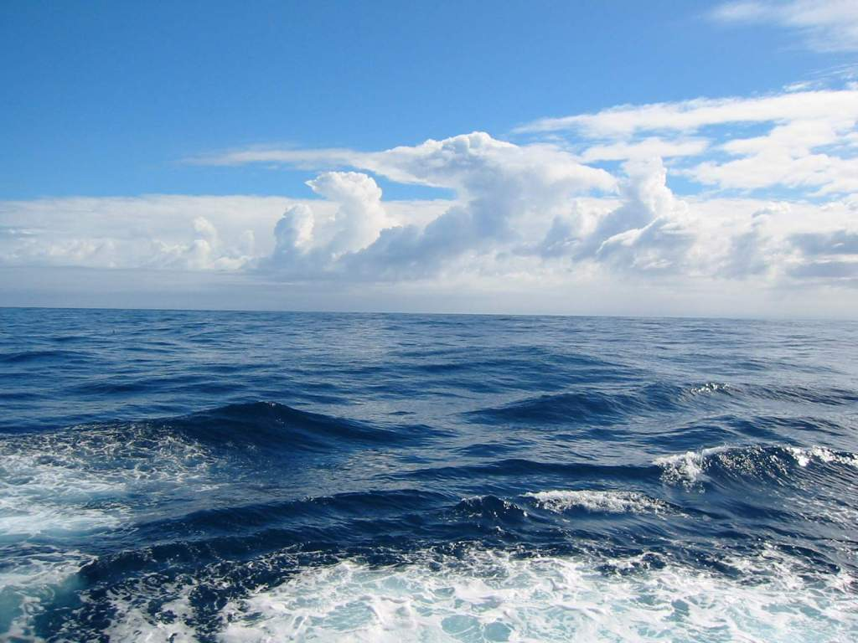
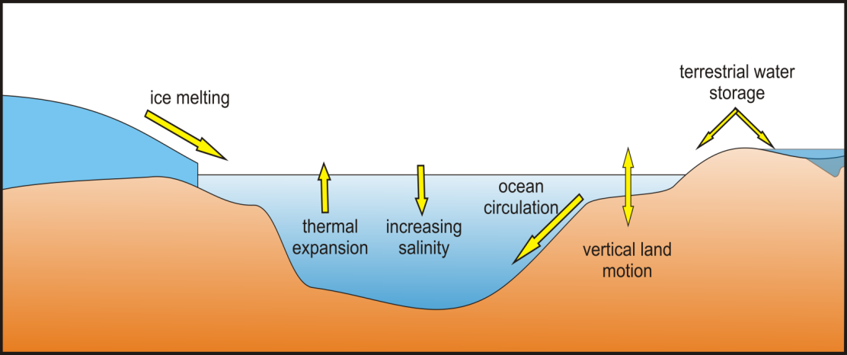
Contributions to sea-level change
Notes:
There several reasons that sea-levels are rising (most, but not all are associated with atmospheric climate change).
There is the thermal expansion of the oceans as climate changes.
For enclosed seas like the Mediterranean and Black seas, if temperature and evaporation increases, increasing salinity lowers sea-level.
There are changes in the terrestrial storage of water, as we build new reservoirs and as we extract and deplete ground-water.
Several of these contributions are relatively straightforward to predict.

Slide 18
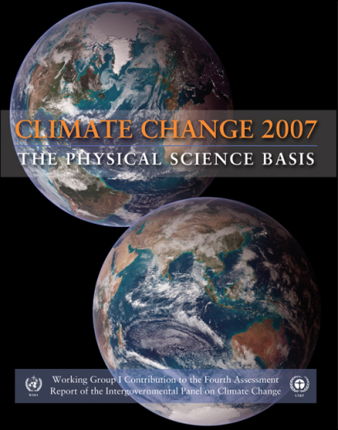
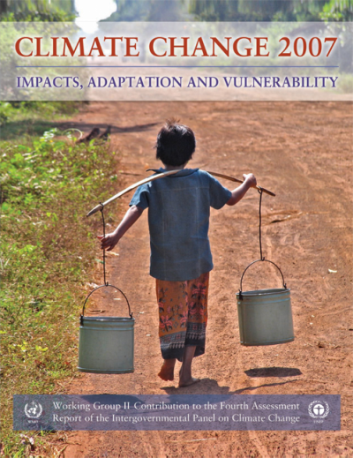
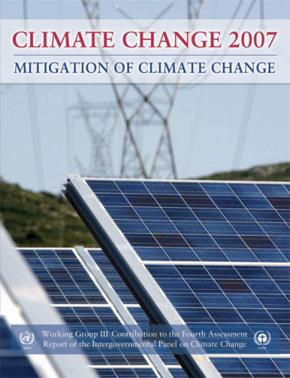
IPCC (2007) on sea-level rise
“…do not include the full effects of changes in ice sheet flow, because a basis in published literature is lacking.”
“…understanding of these effects is too limited to assess their likelihood or provide a best estimate or an upper bound for sea-level rise.”
Notes:
The last Intergovernmental Panel on Climate Change in 2007, highlighted this.
They said that the major remaining uncertainty in sea-level rise was the contribution from the polar ice sheets of Antarctica and Greenland.
In the projections of sea-level rise that they gave, they could not be fully confident that all the possible contributions from ice sheets were included.

Slide 19
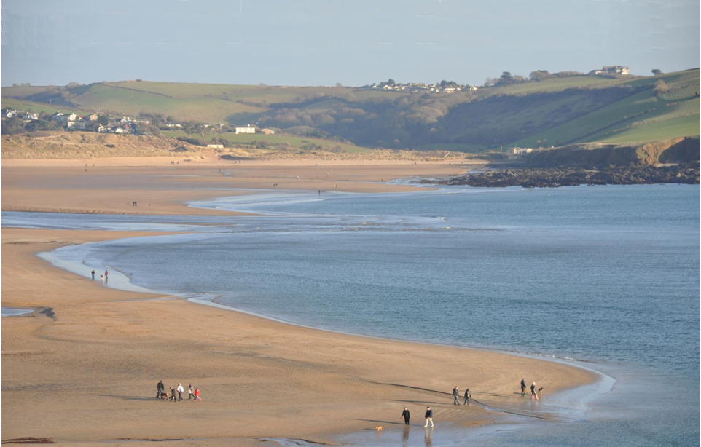
Future sea-level rise?
Pfeffer “plausible limit”
Vermeer and Rahmsdorf, 2009
Deltacommisee upper
IPCC AR4
Upper
Continuation of 1870-present = IPCC AR4 lower
Source: ice2sea
Notes:
I’m going to focus on the period up to 2100 – in line with the IPCC. But, in ice2sea we’ve recognized that some of our national governments have clearly called for rather longer projections. For example the Delta Commission in Netherlands and the UK Environment Agency.
Continuing the mean rate of rise we’ve experienced since 1850, and continuing it to 2100, suggests levels around 20 cm higher than they were at 2000. There is little reason to believe sea-level rise will decrease in future, so that is a reasonable lower bound estimate.
The last IPCC report suggested an upper bound of 58 cm, but we remember they felt that they had not fully included the ice sheet contribution.
Projections that have included those effects suggest that projections significantly higher than that are possible.
In some respects, the range of these projections may not appear to be that significant, so perhaps we need to go into a little more detail here…

Slide 20
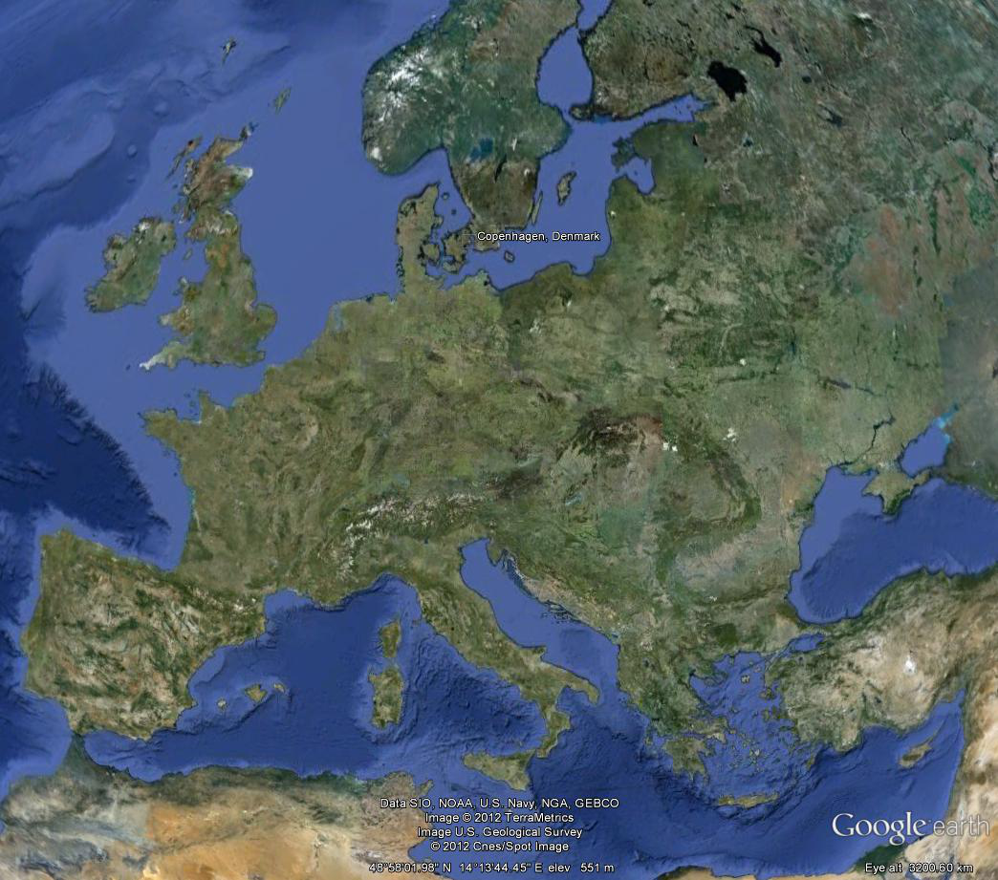
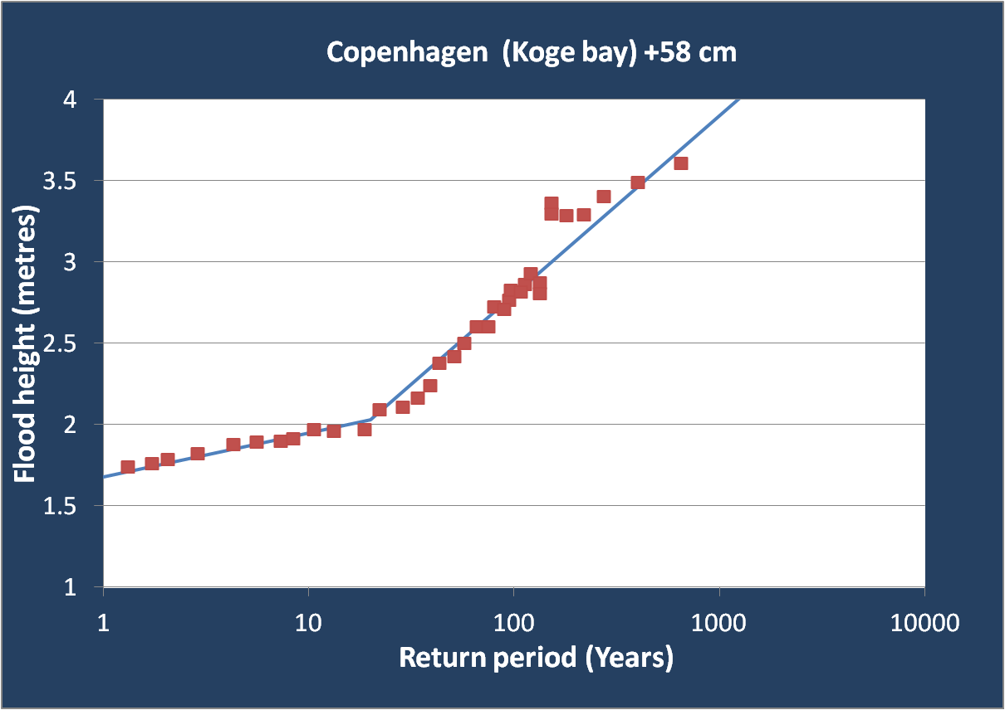
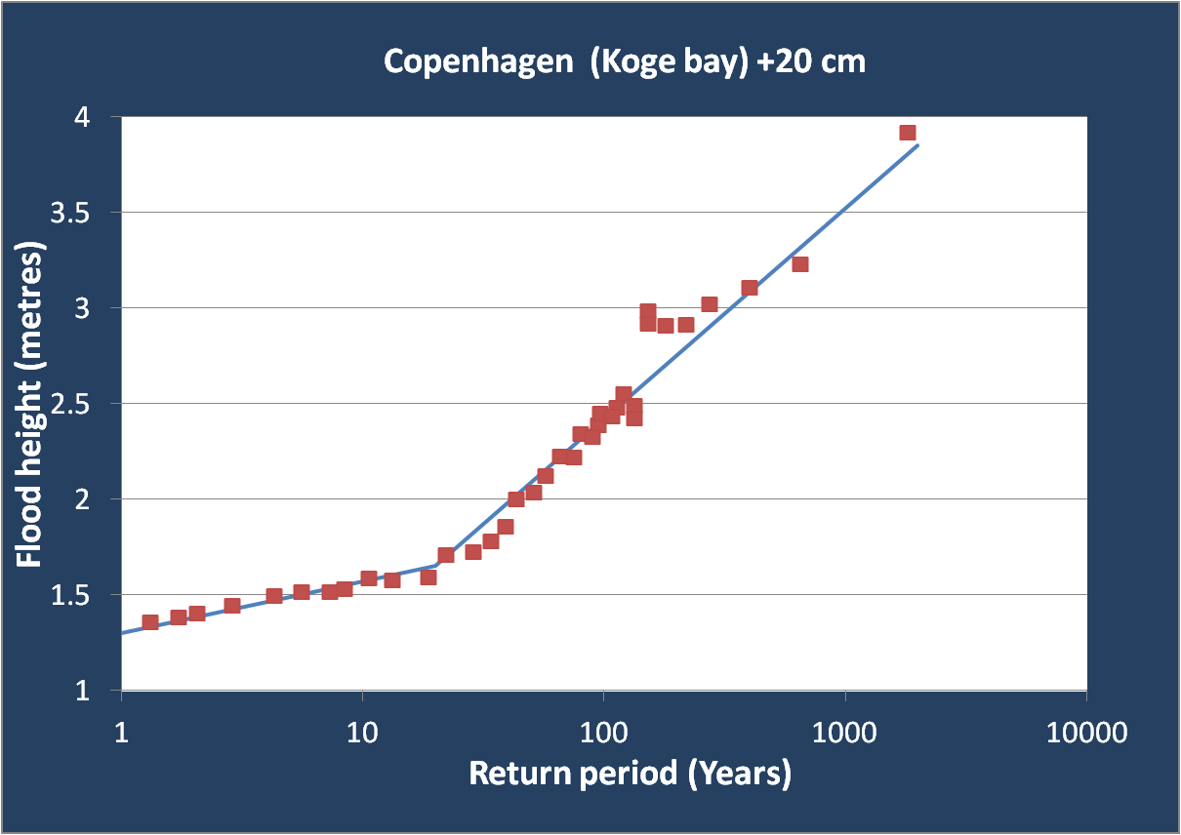
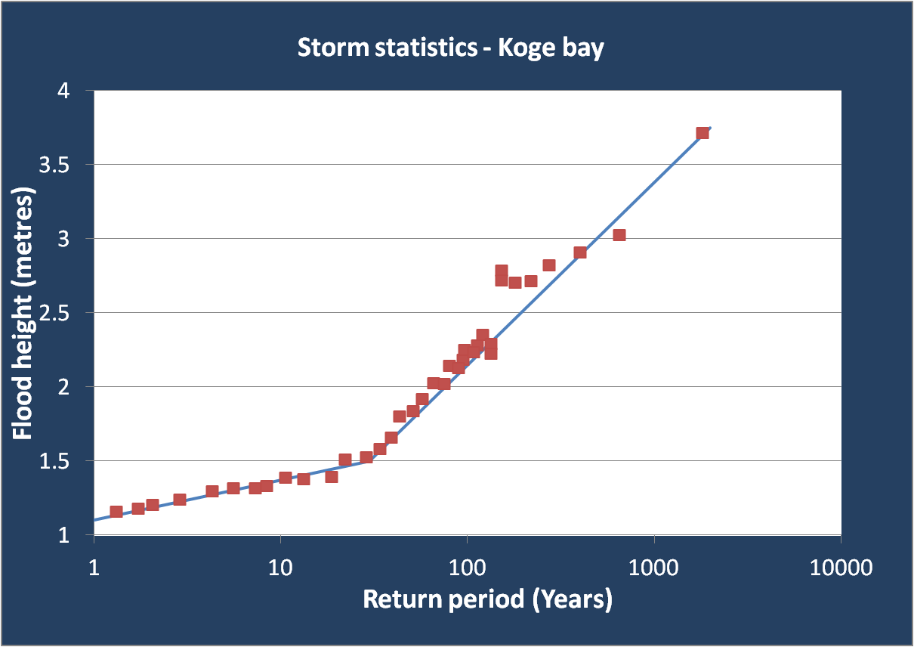
Copenhagen – case study
Hornbaek storm history (Date – Storm height /cm)
1 January 1922 - 173
7 November 1985 - 164
18 December 1921 - 158
2 November 1921 - 154
20 November 1973 - 149
1 March 2008 - 149
4 October 1927 - 146
9 November 2007 - 144
10 October 1923 - 143
16 December 1982 - 141
1922 storm
Carlo Sorensen et al., 2010
Notes:
To show the affect of sea-level rise on storm surge return rates, we show here Copenhagen as an example. It should be noted that in Copenhagen there is also subsidence that might diminish the exact numbers slightly, but the principle remains relevant – similar argument apply to many of the coastal towns and cities around the North Sea.
In common with most of the North Sea coasts, Copenhagen suffers periodic storm surges that are substantially higher than the norm. This happens when storms in the Atlantic drive a mass of water into the North Sea. The shallow water of the North Sea magnifies this surge, and if all the factors coincide (low atmospheric pressure, high tide, etc) we get potentially damaging storms.
We can see from the history of significant storms in the 20th Century at Hornbaek that there was one storm that was 1.73 m above the datum. If we gather enough data, we can develop an idea of the storm statistics for this area, and plot that 173 cm storm onto the statistics (it lies at about the 1-in-80 year event)
But here is the crucial factor….
If we raise the base of sea-level a very small amount, just 20 cm, we can see how that once-in-a-hundred-year event changes, and would arrive about once in 20 years.
Raise sea-level by 58 cm (that’s the IPCC’s upper estimate for 2100) we have that once-in-a-century storm happening very frequently, even annually.
There would obviously be consequences for much increased storms for defence costs, acceptable risk levels, and rebuild costs, if sea defences are not improved.

Slide 21
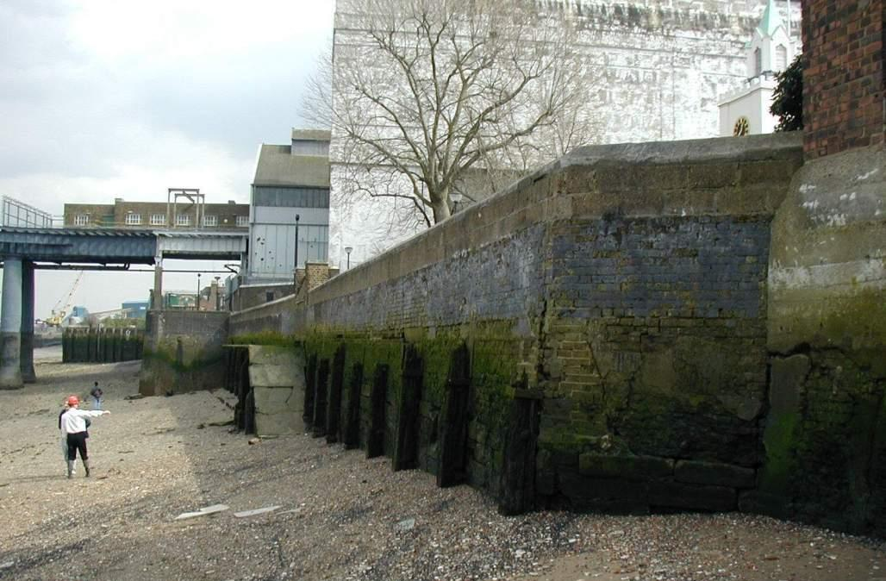
Development of flood defences in London
Interim Defences during Thames Barrier construction
1928 Flood + 1930 Flood Act
Late-C19 update
to Flood Act
1879 Flood Act
    Photo: UK Environment Agency
Notes:
Historically, London has responded in raising sea-defences progressively in response to particularly high storms. London has simply increased the height of the river walls on the banks of the Thames each time there was a storm that overtopped, or nearly overtopped, them. So far London has been lucky, with no major flooding events.

Slide 22
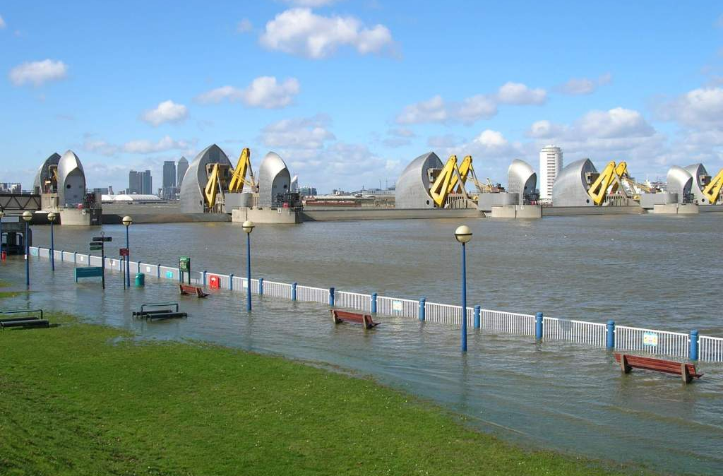
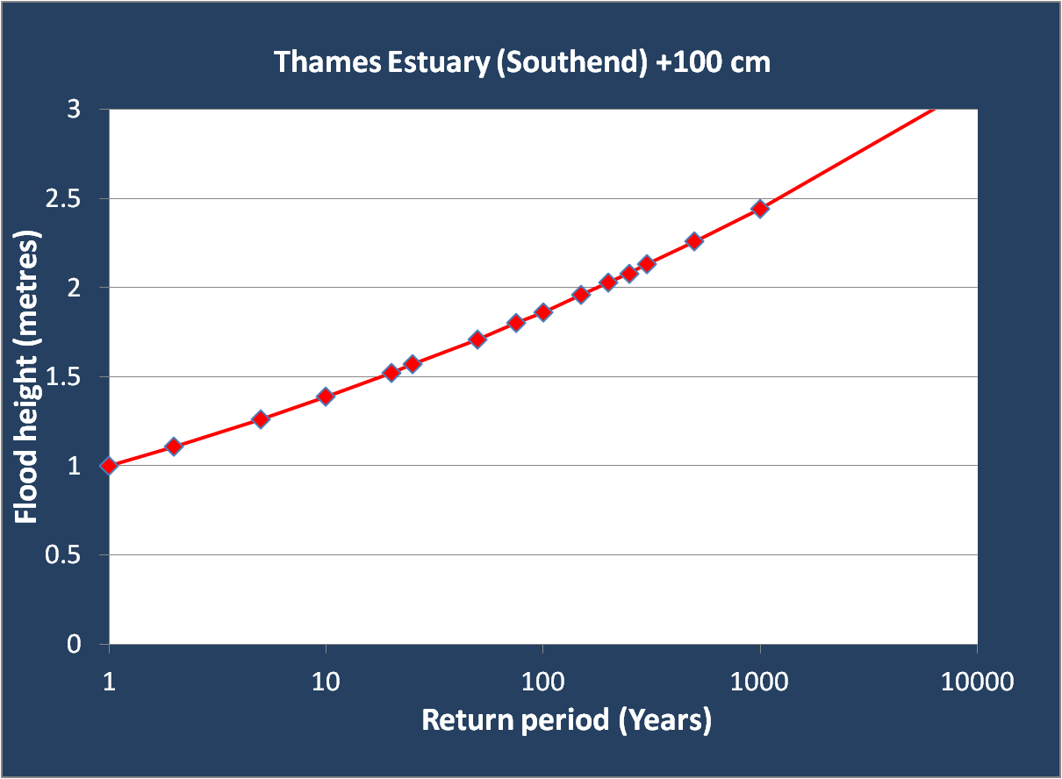
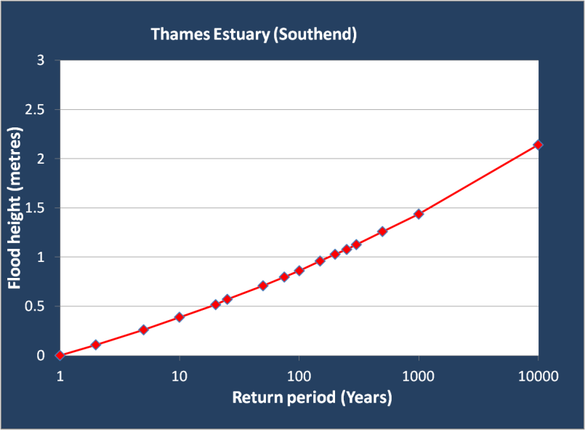
100th closure of the Thames Barrier
    Photo: UK Environment Agency
Notes:
Moving from Flood Defence to Flood Risk Management.
Flood Risk
=
Probability (which decreases as increasingly large defences are built)
X
Consequence (which increases as people move in and develop behind the defences)
We are used to the concept of probability (likelihood) of flooding and it can be measured fairly easily. Consequence is more difficult and our studies are enabling us to measure the risk and the value of reducing the consequence through flood risk management measures within the flood plain. These are known as “Receptor” responses.
After the last storm in 1953, the Thames Barrier was built. It was eventually commissioned in 1983, with a projected useful life for defending London of around 70 years. The Barrier was intended to provide protection that would be breached by storm surges that happen only once in a thousand years.
If we look at the statistics we can see that this could rapidly diminish as a result of sea-level rise. The height of a one-in-a-thousand year flood event is currently around 1.4 metres. If a 1m rise in sea level were to occur, this sized flood event would happen on average every 10 years. This would be an unacceptable risk to the businesses and inhabitants of London.
The UK Environment Agency has a plan to maintain and eventually replace the Thames Barrier, on the basis of sea-level change projections. But the key is not to spend the money too early (before we really know what sea-level will do), and not to spend more than we need in rebuilding too high. (Currently, the majority of expenditure is in improving defences down stream of the Barrier, to prevent flood waters reaching London from around the sides of the Barrier).
In this case reducing uncertainty in sea-level rise may avoid tremendous unwarranted expenditure to the tax-payer, whilst allowing reasonable levels of protection to be maintained.

Slide 23
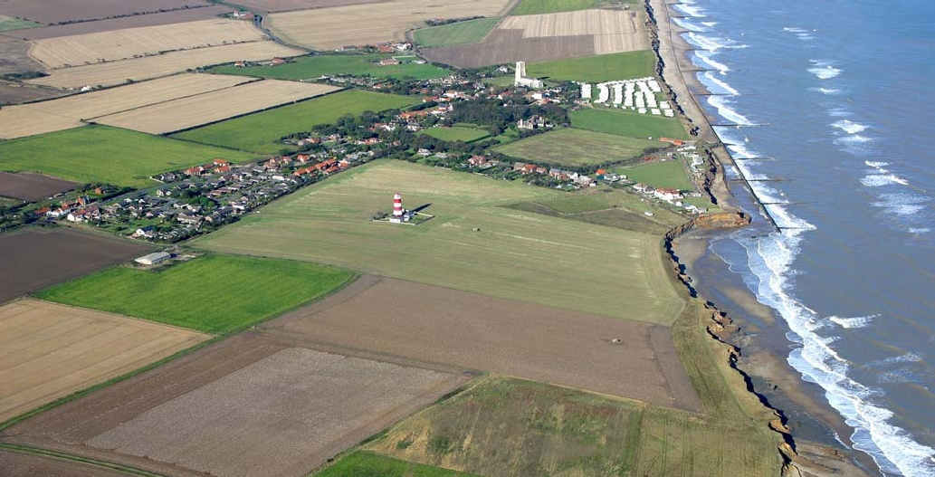
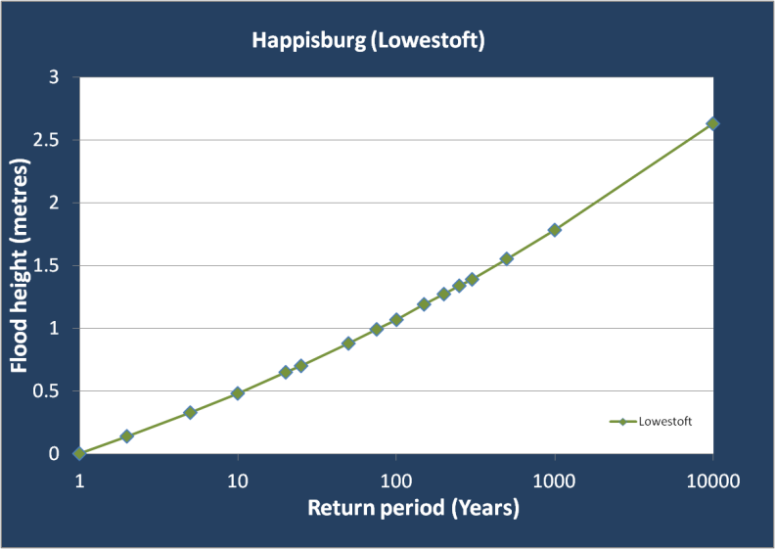
Happisburgh (East of England)
    Photo: UK Environment Agency
Notes:
Moving from Flood Defence to Flood Risk Management.
Flood Risk
=
Probability (which decreases as increasingly large defences are built)
X
Consequence (which increases as people move in and develop behind the defences)
We are used to the concept of probability (likelihood) of flooding and it can be measured fairly easily. Consequence is more difficult and our studies are enabling us to measure the risk and the value of reducing the consequence through flood risk management measures within the flood plain. These are known as “Receptor” responses.
This is an example of another type of coastline, which is not so significantly built up. In this case reducing uncertainty in sea-level rise may help local authorities avoid development and reduce investment by private companies of potentially vulnerable near coastal areas, where such expensive flood defences would not be practical.

Slide 24
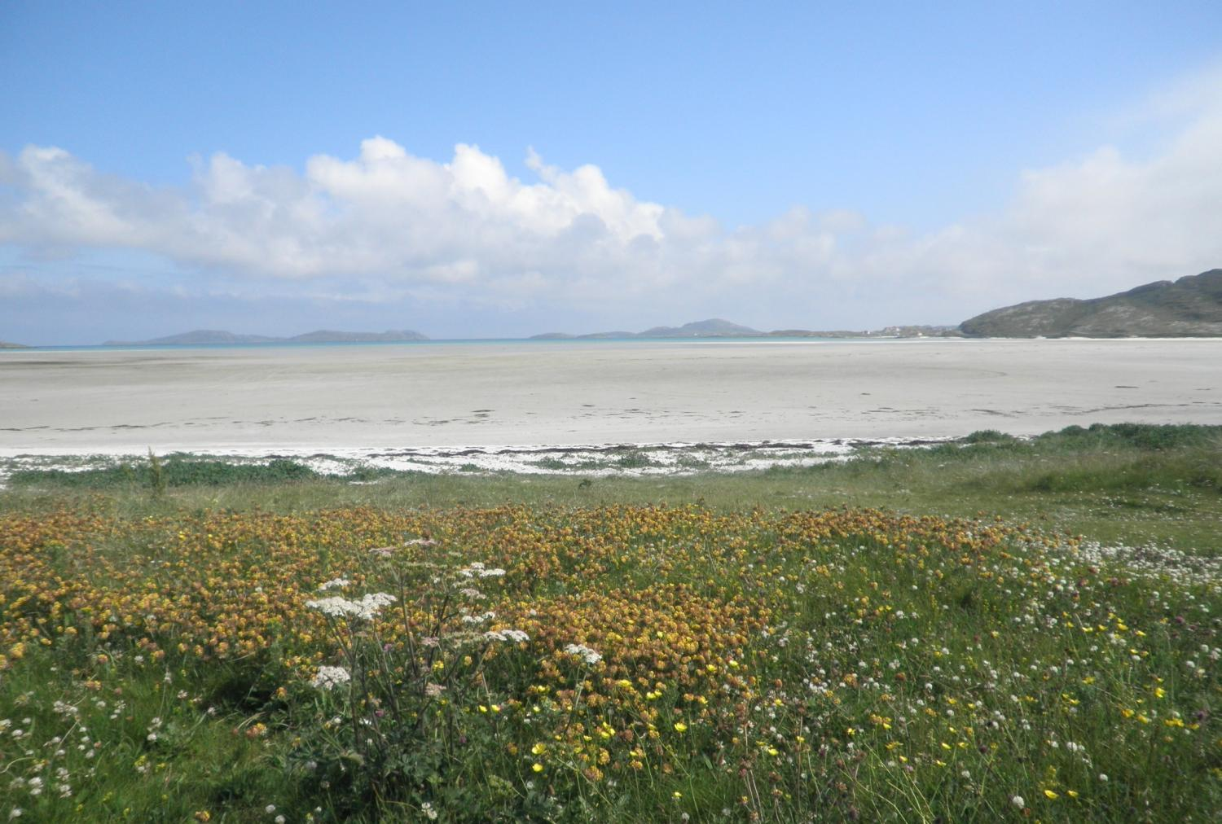
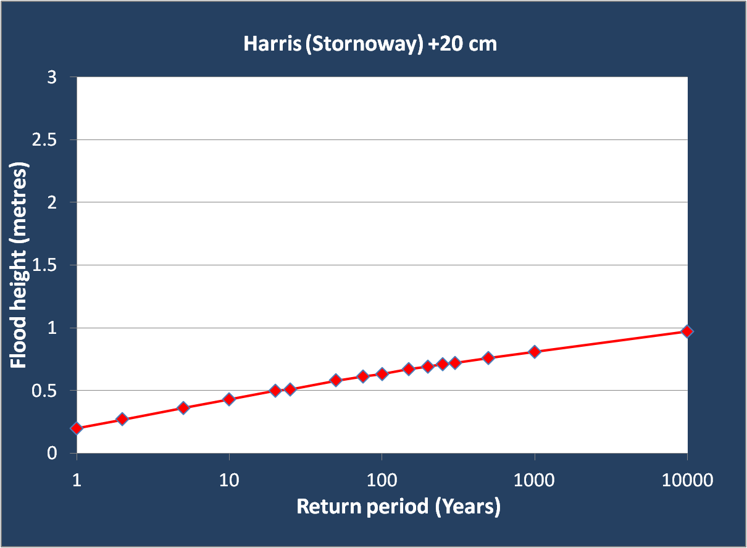
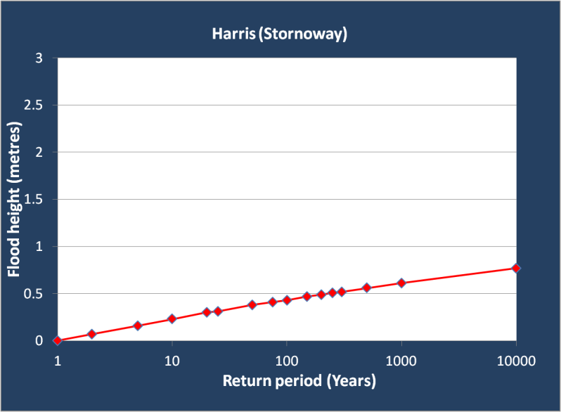
Isle of Harris (Scotland)
    Photo: Alison Cook
Notes:
Moving from Flood Defence to Flood Risk Management.
Flood Risk
=
Probability (which decreases as increasingly large defences are built)
X
Consequence (which increases as people move in and develop behind the defences)
We are used to the concept of probability (likelihood) of flooding and it can be measured fairly easily. Consequence is more difficult and our studies are enabling us to measure the risk and the value of reducing the consequence through flood risk management measures within the flood plain. These are known as “Receptor” responses.
Finally, let’s go back to one of those unique coastal habitats on the Atlantic coast. The storm statistics here are quite different. There aren’t the occasional big surge events that occasional hit those North Sea coasts. So raising sea-level even just a small amount means that there is a likelihood of getting storms that have never been seen before.
For example, the storm that used to arrive once in 1-in-100 years, and was infrequent enough to be survived, with only 20 cm of rise (that’s the lower IPCC projection) arrives around every 12 years.
In this case reducing uncertainty in sea-level rise may allow us to identify pathways for migration, and in particular areas that are worth maintaining because they are less vulnerable than others.

Slide 25
IPCC (2007) on sea-level rise
“…do not include the full effects of changes in ice sheet flow, because a basis in published literature is lacking.”
“…understanding of these effects is too limited to assess their likelihood or provide a best estimate or an upper bound for sea-level rise.”
Notes:
As we mentioned before, in its last report, the IPCC noted that the major uncertainty in sea-level rise was the contribution from the continental ice sheets of Antarctica and Greenland.
In simple terms, in 2007, the IPCC could see that the polar ice sheets of Antarctica and Greenland were losing ice, and this appeared to be a response to climate change, but they were not sure (for a variety of reasons) what will happen in the future.

Slide 26
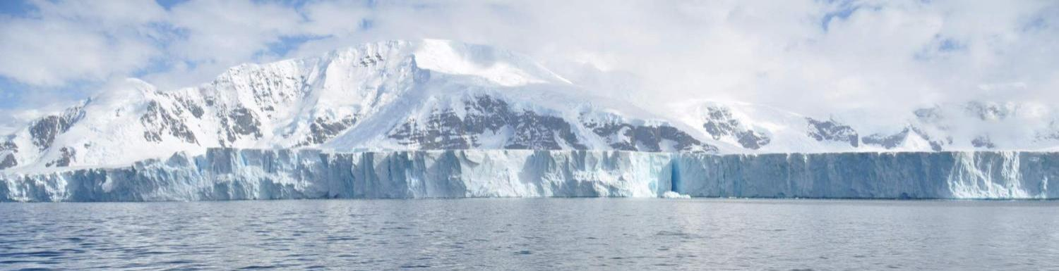
























Notes:
Our response here has been the ice2sea project. This is a programme developed under European Union Framework 7 funding. It involves 24 partners in Europe, and in Chile. It represents a completely new level in the inter-connectedness and strategic organisation in this area of science.

Slide 27
Policy-relevant goals for ice2sea
Develop tools and understanding for sea-level projections
Provide improved projections of the contribution of continental ice to sea-level to 2200
Train and equip a new generation of scientists to take the work forwards
Notes:
Moving from Flood Defence to Flood Risk Management.
Flood Risk
=
Probability (which decreases as increasingly large defences are built)
X
Consequence (which increases as people move in and develop behind the defences)
We are used to the concept of probability (likelihood) of flooding and it can be measured fairly easily. Consequence is more difficult and our studies are enabling us to measure the risk and the value of reducing the consequence through flood risk management measures within the flood plain. These are known as “Receptor” responses.
The elements of the goals of ice2sea that will support policy are shown here…

Slide 28
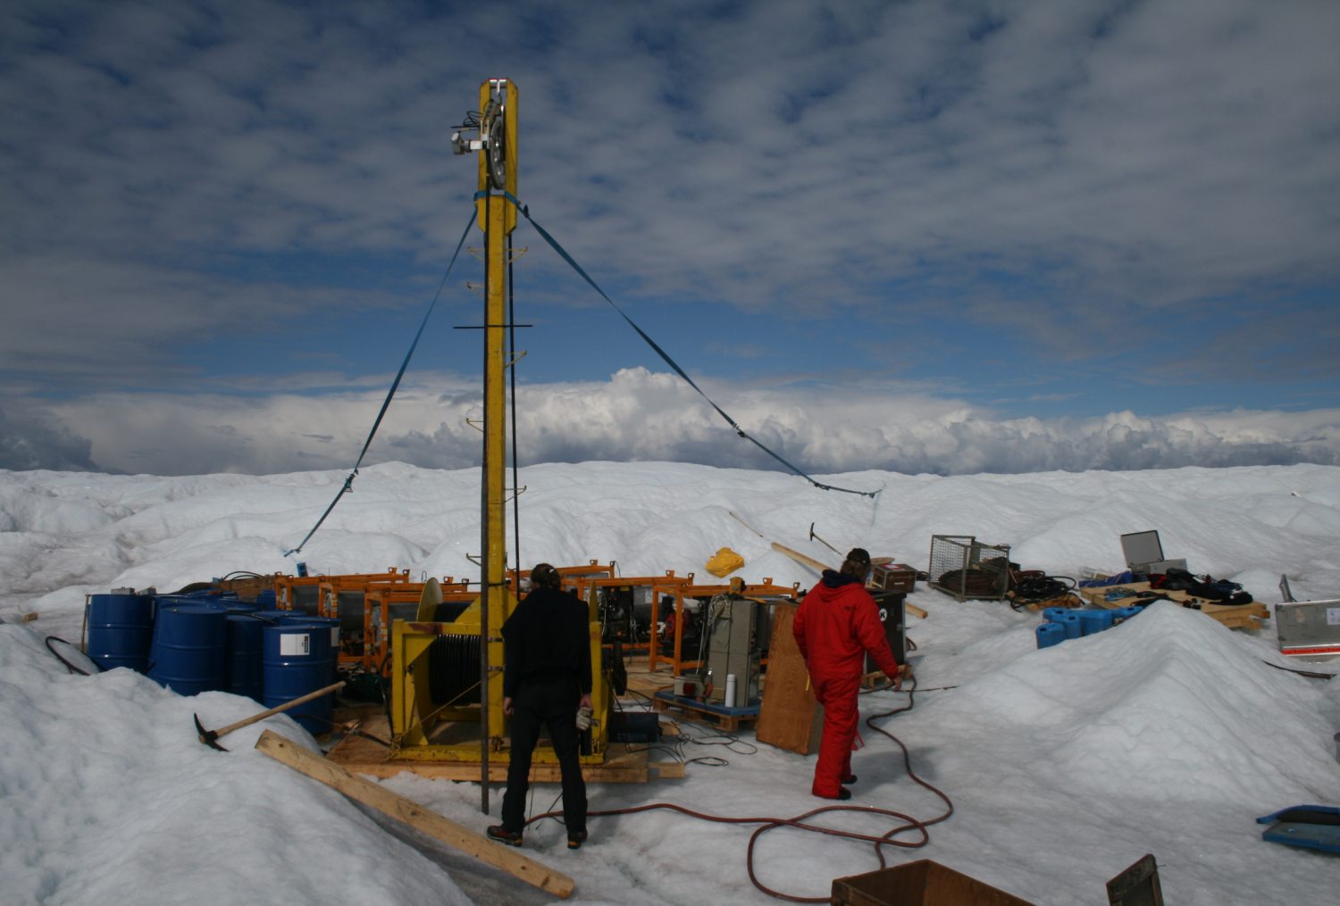
Russell Glacier, Greenland
Photo: Paul Smeets
Notes:
Moving from Flood Defence to Flood Risk Management.
Flood Risk
=
Probability (which decreases as increasingly large defences are built)
X
Consequence (which increases as people move in and develop behind the defences)
We are used to the concept of probability (likelihood) of flooding and it can be measured fairly easily. Consequence is more difficult and our studies are enabling us to measure the risk and the value of reducing the consequence through flood risk management measures within the flood plain. These are known as “Receptor” responses.
Ice2sea has undertaken fieldwork in Antarctica and Greenland, including drilling to bottom of the Greenland ice sheet, to see how climate warming might affect the degree to which lubrication of ice-flow.

Slide 29
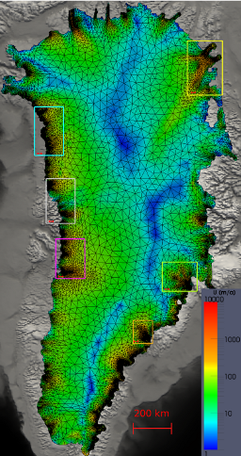
New generation of models
Gillet-Chaulet et al., in review
Notes:
Moving from Flood Defence to Flood Risk Management.
Flood Risk
=
Probability (which decreases as increasingly large defences are built)
X
Consequence (which increases as people move in and develop behind the defences)
We are used to the concept of probability (likelihood) of flooding and it can be measured fairly easily. Consequence is more difficult and our studies are enabling us to measure the risk and the value of reducing the consequence through flood risk management measures within the flood plain. These are known as “Receptor” responses.
We’ve developed a new generation of ice sheet models, that we can use to simulate the behaviour of ice sheets under a variety of scenarios. This map of Greenland shows flow rates, but what is new here is the way it is mapped. The coastal areas, in particular the areas in the boxes, which are key outlet glaciers – important for holding the ice in the ice sheet – are at a much higher grid scale (spatial resolution) than the central parts of the ice sheet. This allows a better balance of understanding the interesting details, whilst keeping computing resources requirements to a minimum.

Slide 30
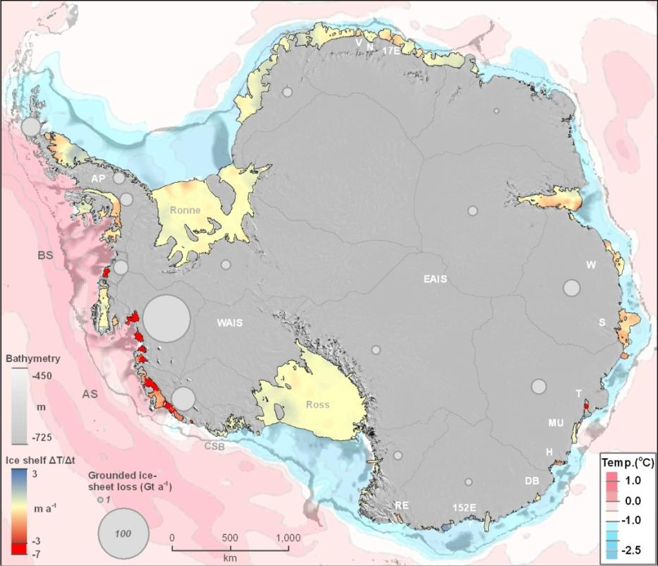
Antarctic ice sheet loss
Antarctic ice sheet loss is driven by warm water
Pritchard et al., Nature, 2012
Notes:
Moving from Flood Defence to Flood Risk Management.
Flood Risk
=
Probability (which decreases as increasingly large defences are built)
X
Consequence (which increases as people move in and develop behind the defences)
We are used to the concept of probability (likelihood) of flooding and it can be measured fairly easily. Consequence is more difficult and our studies are enabling us to measure the risk and the value of reducing the consequence through flood risk management measures within the flood plain. These are known as “Receptor” responses.
In one of our first studies, we made the striking discovery that it is warm water (pink) which is causing the majority of current ice-loss (red) from the Antarctic ice sheet.

Slide 31
Hartmut Hellmer
Alfred Wegener Institute for Polar and Marine Research
The uncertain future of a large Antarctic ice shelf
Notes:
We are showing here two examples of some of the work recently done in ice2sea – Hartmut Hellmer is leader of Work Package 4, and is showing work also on Antarctica, that has been recently published in Nature (http://www.nature.com/nature/journal/v485/n7397/full/nature11064.html)

Slide 32
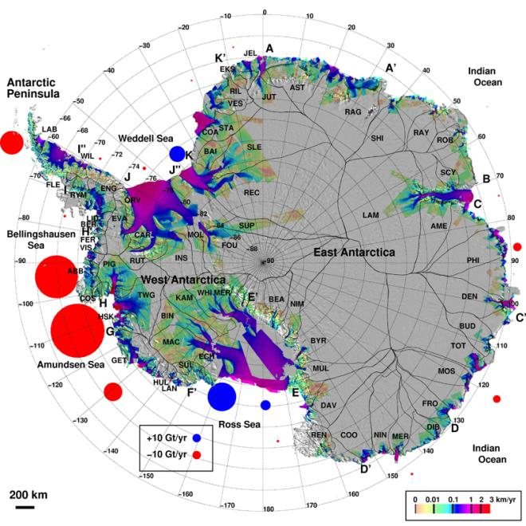
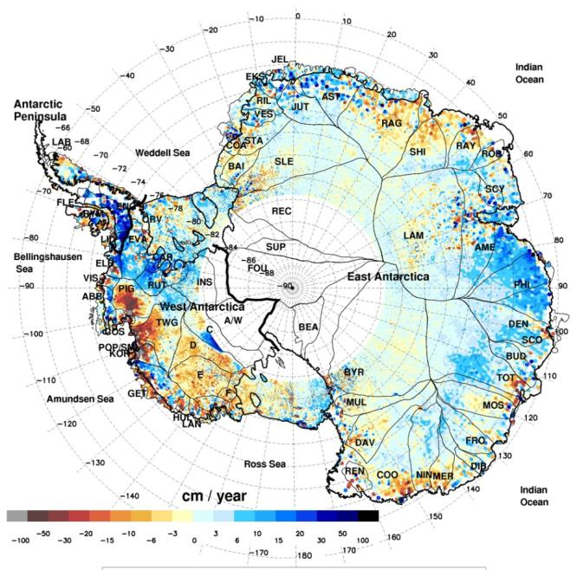
Understanding ice-sheet mass balance
Ice velocity
Elevation change (1992-2005)
Rignot et al. (2008)
Notes:
Remotely sensed ice stream velocities and ice sheet elevation are used to deduce Antarctic ice sheet mass balance. It is clear that several independent techniques agree that ice is being lost from parts of the Antarctic ice sheet at a substantial rate.

Slide 33
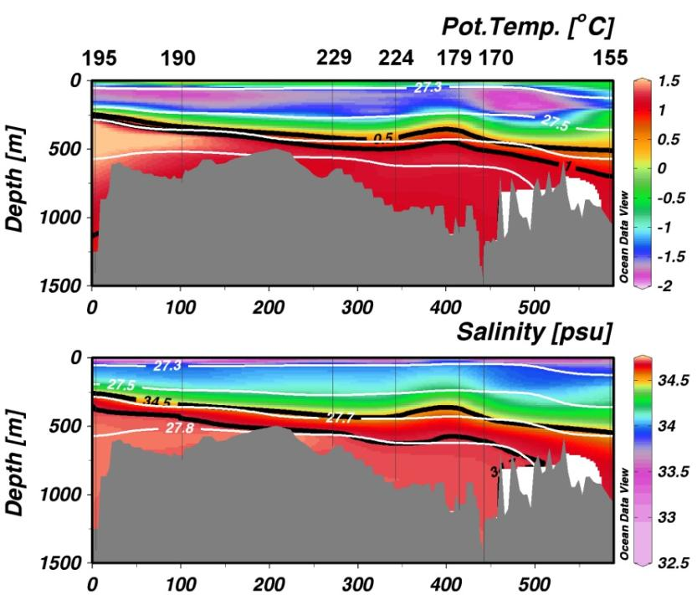
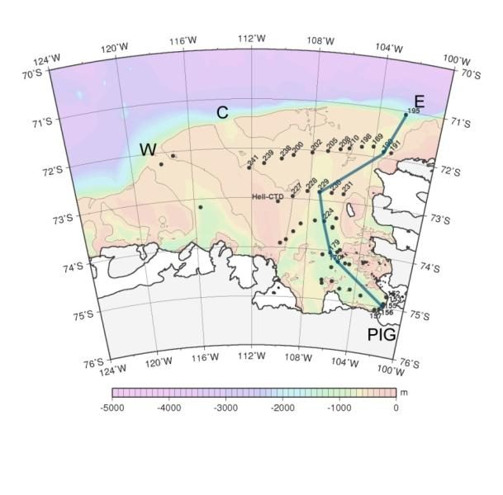
Advancing Circumpolar Deep Water
ANT XXVI/3 - 2010
Nakayama & Schröder (2012)
Notes:
Hydrographic measurements in the eastern Amundsen Sea, an area of the ice sheet that shows rapid ice loss, indicates that warmer Circumpolar Deep Water (CDW) is making its way onto the continental shelf into Pine Island Bay. This is the major reason for ice-loss in this part of Antarctica, and raises concerns about whether in future similar changes may occur elsewhere around the continent.

Slide 34
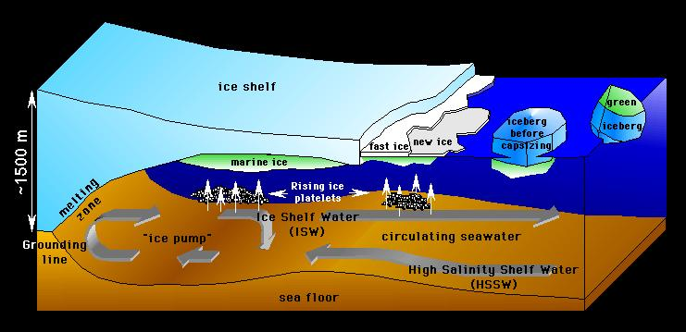
Circulation underneath an Antarctic ice shelf
G Dieckmann
Notes:
The mechanisms by which the ocean delivers heat to the ice sheet and causes it to melt are complex, but are captured in the most up-to-date oceanographic models run at Alfred Wegener Institute.
This shows a schematic of the circulation underneath a large Antarctic ice shelf.

Slide 35
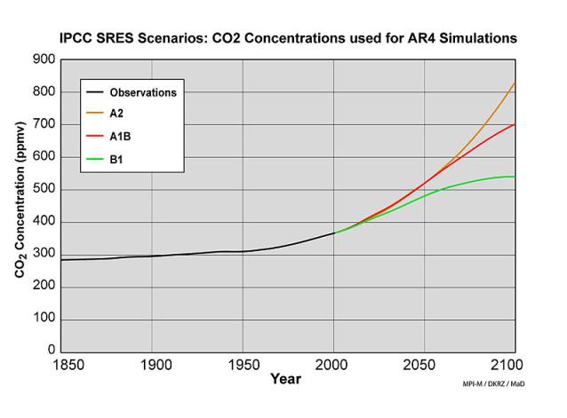
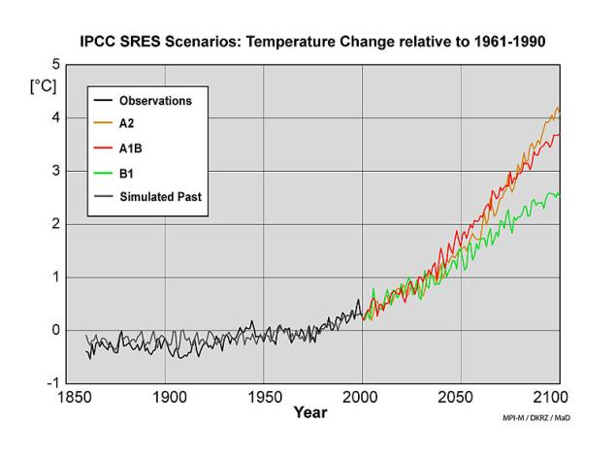
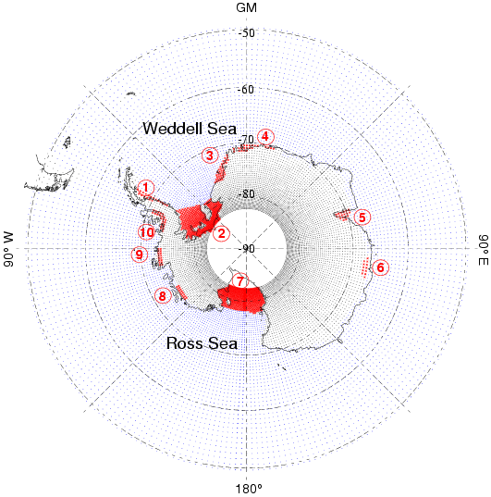
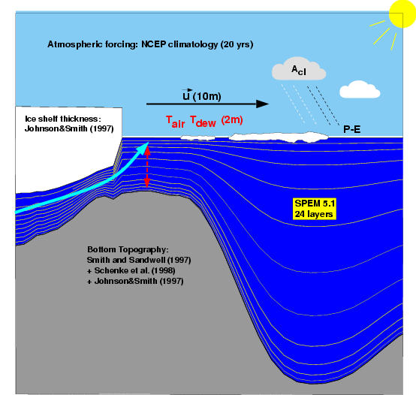
BRIOS ocean model driven by emissions scenarios
Forcing
BRIOS
Bremerhaven
Regional
Ice
Ocean
Simulations
Notes:
In the study described here, we have driven a Regional Ocean Circulation Model (ROCM) BRIOS (lower panels), using IPCC class global climate models for different carbon emission scenarios (upper left), that shows temperature increases (upper right).

Slide 36
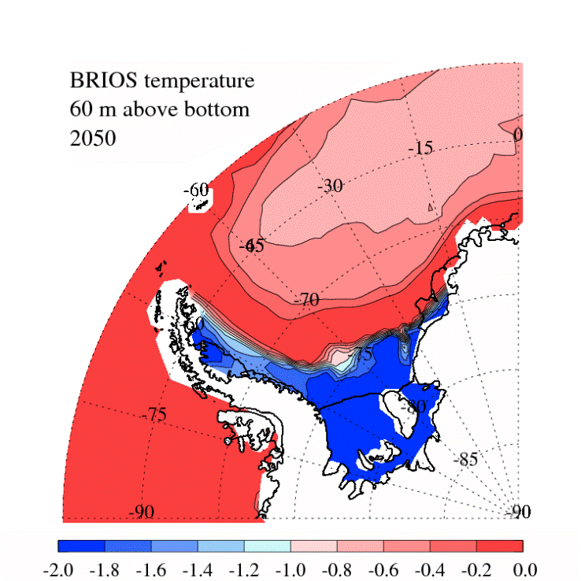
Evolution of temperature in the Weddell Sea
2050 to 2099
Notes:
Movie showing the evolution of bottom temperature in the Weddell Sea from 2050 to 2099. This shows that over time increasingly “warm” waters are moving in from the deep waters into the Weddell Sea, where an ice shelf sits. This will increase melting of the ice shelf from below.
(Note that although these are described as warm waters, the saline waters are indeed still below zero, but are still warm enough to melt the ice they come in contact with.)

Slide 37
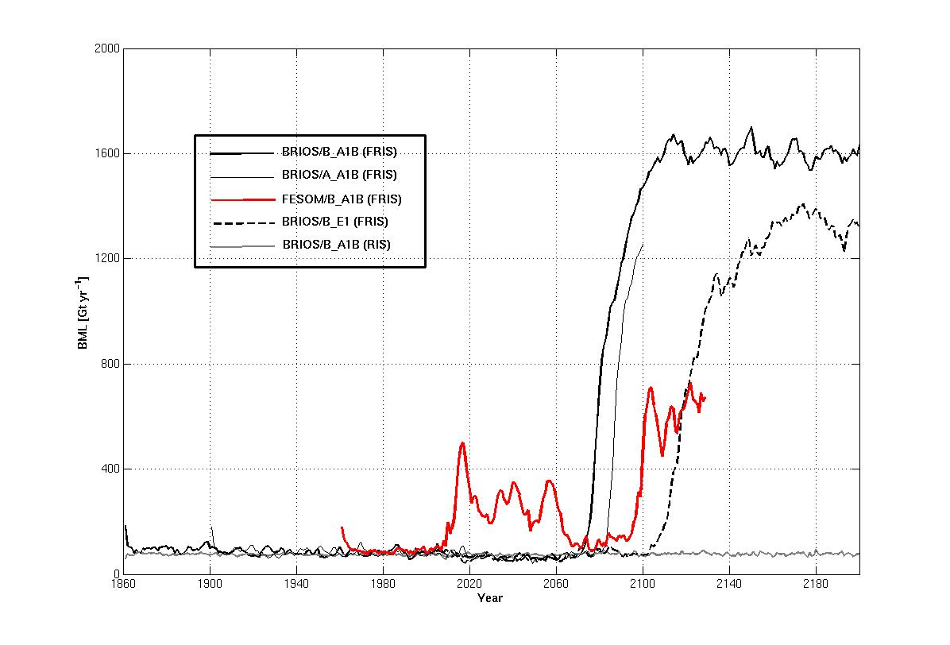
Ice loss from Filchner-Ronne Ice Shelf
Notes:
In response to the changing ocean condition predicted by BRIOS, we calculate the evolution of basal ice loss (BML) in Gt/yr (1 Gt = 10^12 kg) from the Filchner-Ronne Ice Shelf (FRIS) for different AR4-scenarios and models as a consequence of the FRIS-cavity warming.
The robust feature of this simulation is a rapid increase in ice-loss in the FRIS in the late 21st Century. It occurs in both models, and both scenarios. No similar change occurs around the rest of Antarctica.

Slide 38

Weddell Sea salinity and density evolution
σ₀
Notes:
Those changes in ice-loss are the result of changes in the ocean water masses reaching the ice as shown by these model results.

Slide 39

Evolution of the SE Weddell Sea
Notes:
The fundamental cause of the changes we have identified is in the way that winds and sea-ice affect the rate at which warm ocean water is drawn onto the ice continental shelf.
Evolution of sea ice volume (upper) and surface stress (wind, middle) for the southeastern Weddell Sea (Filchner Trough) compared with the FRIS-BML (similar to slide 37).

Slide 40


Processes controlling Weddell Sea circulation
Today
2070
Notes:
Schematic of the processes controlling today (left) and in the 2070 (right) the circulation on the southern Weddell Sea continental shelf. The sea ice currently present will no longer be able to hold back the warm circumpolar waters from entering the cavity below the ice shelf, due to the reduced salinity (the vertical arrow from the front of the ice shelf to the high point of the sea bed) caused by less sea ice being formed. These warm waters will then increase the melting of the ice shelf, eventually causing it’s break up into icebergs, and eventual retreat to the grounding line (where the ice meets the sea floor), or beyond.

Slide 41


Future Actions
Planned distribution of
hydrographic stations:
POLARSTERN Cruise
ANT XXIX/9
Jan 2013 – March 2014
Notes:
The model results still need more validation, and as a baseline future monitoring AWI have planned to establish hydrographic measurements and moorings in the southeastern Weddell Sea for the PolarStern cruise in 2014. This will allow us to see if and when predicted changes begin to occur.

Slide 42

Notes:
(The PolarStern is AWI’s icebreaker ship, which was used to gather the data presented here from cruises in the Southern Ocean.)

Slide 43
Frank Pattyn
Universite libre de bruxelles, Belgium
Understanding and projecting ice loss
Notes:
Frank Pattyn is the Work Package 2 leader, and is presenting work that is soon to be published on modelling of Greenland’s outlet glaciers.

Slide 44


Ice loss of major ice sheets
-30±11 Gt/yr²
-26±14 Gt/yr²
Velicogna, 2009
A quadratic function of time describes the observations well, but to make projections we need physically based models.
Notes:
Recent measurements using a satellite that measures the mass of ice in the ice sheets shows increasing rates of ice-loss from Greenland and Antarctica. However satellites can only measure present changes; prediction of future changes requires ice sheet models that are based on understanding of the underlying physics.

Slide 45

Larsen ice shelf breakup: natural experiment
Scambos et al,2004
Notes:
There are several processes that need to be captured in those models.
Around the Antarctic Peninsula ice-shelf retreat has driven ice-sheet loss…

Slide 46




Greenland outlet glaciers
Petermann
Rapid changes reflect short-term climate/oceanic forcing
Ability to adjust rapidly
Caution with interpreting rapid dynamic changes
  (Joughin et al., 2008, Vieli & Nick, 2011, Nick & Vieli et al, 2009)
Falkner et al., 2011
Kangerdlugssuaq
Howat et al. 2005
Jakobshavn
Helheim
Joughin et al. 2004
Howat et al. 2005
Notes:
...in Greenland similar processes involving marine-terminating glaciers has led to glacier acceleration and ice loss in recent years.

Slide 47

Greenland
Individual glaciers show large variability (speed up – slow down)
Knowledge of glacier geometry (basal topography) is crucial
Essential to have models that capture the small-scale change
Moon et al, 2012
Notes:
Individual glaciers have shown large variability (speed up or slow down). For projections, a good knowledge of glacier geometry (basal topography) is crucial, and it is essential to have models that capture the small-scale changes. This complex picture shows that nearby glaciers may have quite different rates of change, and this may change between different time-periods.

Slide 48


Model initialization: reproducing the observed
Gillet-Chaulet et al., 2012
Models incorporating necessary physics resolved at sufficiently small scale are capable of reproducing observed ice flow and recent changes (thinning)
Notes:
Ice2sea has recently developed the most sophisticated models to capture those high-resolution changes. These models correctly capture present rates of ice flow (data (a) vs. model (b) results on right panels.)

Slide 49






Glacier geometry and velocity pre 1996-2000 changes
Helheim
Kangerdlugssuaq
Flux: 26.3 km³/yr
Flux: 27.8 km³/yr
Elevation (m a.s.l.)
Speed (km/yr)
Elevation (m a.s.l.)
Speed (km/yr)
Thickness ~ 700 m
Width= 6 km
Thickness ~ 850 m
Width= 6 km
Jakobshavn
Petermann
23.6 km³/yr
12.8 km³/yr
Elevation (m a.s.l.)
Speed (km/yr)
Elevation (m a.s.l.)
Speed (km/yr)
Thickness ~ 650 m
Width= 10 km
Thickness ~ 30 m
Width= 20 km
Distance from ice divide (km)
Distance from ice divide (km)
Notes:
Ice2sea has studied several of the most significant glaciers in some detail, to ensure that the detailed dynamics of such glacier can be captured in the large-scale models.

Slide 50

Melting, calving, grounding line retreat
When a glacier comes into contact with the ocean, melting leads to:
  thinning of ice shelf
  loss of pinning (buttressing)
  ice flow acceleration
  increased calving
  retreat of grounding line
  ice flow acceleration
  increased calving
  …
  sea-level rise
Notes:
The aim of this work package has been to express this picture and all these processes in mathematical terms. The key processes that ice2sea seeks to capture in models are associated with the interaction of the glaciers and oceans.

Slide 51


Modelling ice-ocean interaction (calving)
Gradient in longitudinal stress
Numerical flow-line model forced by
Ocean surface Temperature
Surface runoff
Air temperature
ICE FLOW
Lateral drag
Basal drag
Boundary conditions
Resistance from sea ice/ice mélange
Calving criterion
Submarine melt
Nick et al, 2012
Notes:
Many of these processes can now be represent in the mathematical descriptions encoded in the models.

Slide 52

Ice2sea predicted sea-level contribution of major Greenland glaciers
Nick et al, in prep.
Notes:
Specific focus has been placed on identifying representative glaciers, and establishing projections for these - initially in isolation, but for later incorporation in the continental-scale models. These projections represent ice-loss from four key glaciers, for a variety of atmospheric emission scenarios.

Slide 53


Model intercomparison and verification
Pattyn et al, 2012, in prep.
What are the minimum physics requirements?
What spatial resolution is needed to capture essential processes?
International effort to intercompare models
Verification with theoretical models
Notes:
Another activity that has been led by ice2sea, but which involves researchers from many countries, is model intercomparison. This is akin to the activities being undertaken on Global Climate Models within the IPCC community. It seeks to establish benchmarks against which new models can be tested. Some models are highlighted as performing differently to others!

Slide 54
Summary
IPCC AR4 (2007):
  Dynamical processes related to ice flow not included in current models but suggested by recent observations could increase the vulnerability of the ice sheets to warming, increasing future sea level rise. Understanding of these processes is limited and there is no consensus on their magnitude.
2012
  Improved understanding of physical processes that ‘matter’
  Models reproduce the observed flow/thinning
  Regional projections based on physically sound processes
  Global projections will still involve a form of up-scaling
Notes:
Ice2sea will contribute to improved understanding in the 2012 development of the upcoming IPCC report.

Slide 55
Integration & roadmap
David Vaughan

Slide 56

Integration of modelling in ice2sea
Notes:
The important thing is how we’re putting all these elements of knowledge together (those shown in this presentation, and all the other components of ice2sea’s work.
The modelling approach we have developed could only have been created through such a programme as ice2sea, since it involves an end-to-end approach. For the first time, it will allow us to make projections of ice-sheet change, based on individual emissions scenarios, that account for all the major factors.

Slide 57

Global distribution of projected sea-level rise
Relative sea-level rise in 2100 (upper bound scenario)
Notes:
Before that, just a sneak preview of some work that is hot off the press, and has not yet been submitted for peer-review, but about which I’m excited to talk.
Earlier on, I suggested that sea-level rise around the world is currently not uniform. Here, we have been looking at the major factor that causes that pattern, and here are our predictions for a high scenario of sea-level rise. Roughly-speaking the Pacific islands get it worst. Europe does OK.

Slide 58
Roadmap on sea-level rise
Current – finalising the elements of ice-modelling
31st July 2012 – Submission of scientific papers supporting IPCC WGI AR5
Review of ice2sea global sea-level projections and development of European perspective
April 2013 – Publication of ice2sea briefing document on sea-level change
19th Sept. 2013 – publication of IPCC Working Group I AR5 Summary for Policy Makers
Notes:
This shows key dates for the remainder of the project (which is funded until November 2013).

Slide 59

Questions?
Notes:
If you have any questions on this presentation or anything on the project or sea-level rise in general, please contact the Programme Manager Elaina Ford, who will either answer your query or put you in touch with the most appropriate person to do so. Email at ice2sea@bas.ac.uk, phone +44(0)1223 221 453.
See www.ice2sea.eu for further details.

